Slide 1
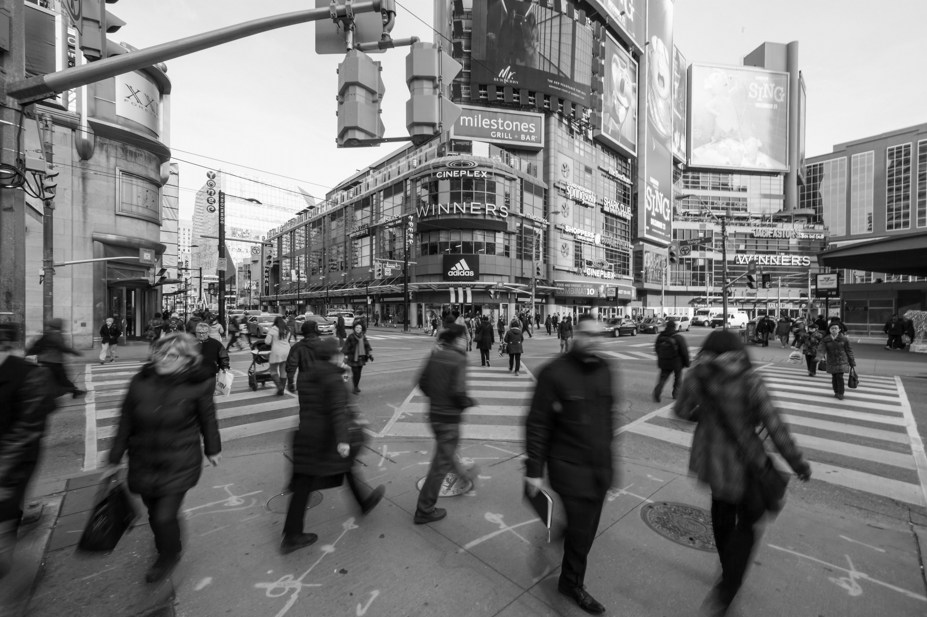



Discrete Choice Modeling for Travel Behavior Analysis: From Multinominal Logit to More Advanced Forms
C2SMARTER Student Learning Hub Series
Xiyuan Ren, Department of Civil and Urban Engineering, New York University
April 11, 2025

Slide 2
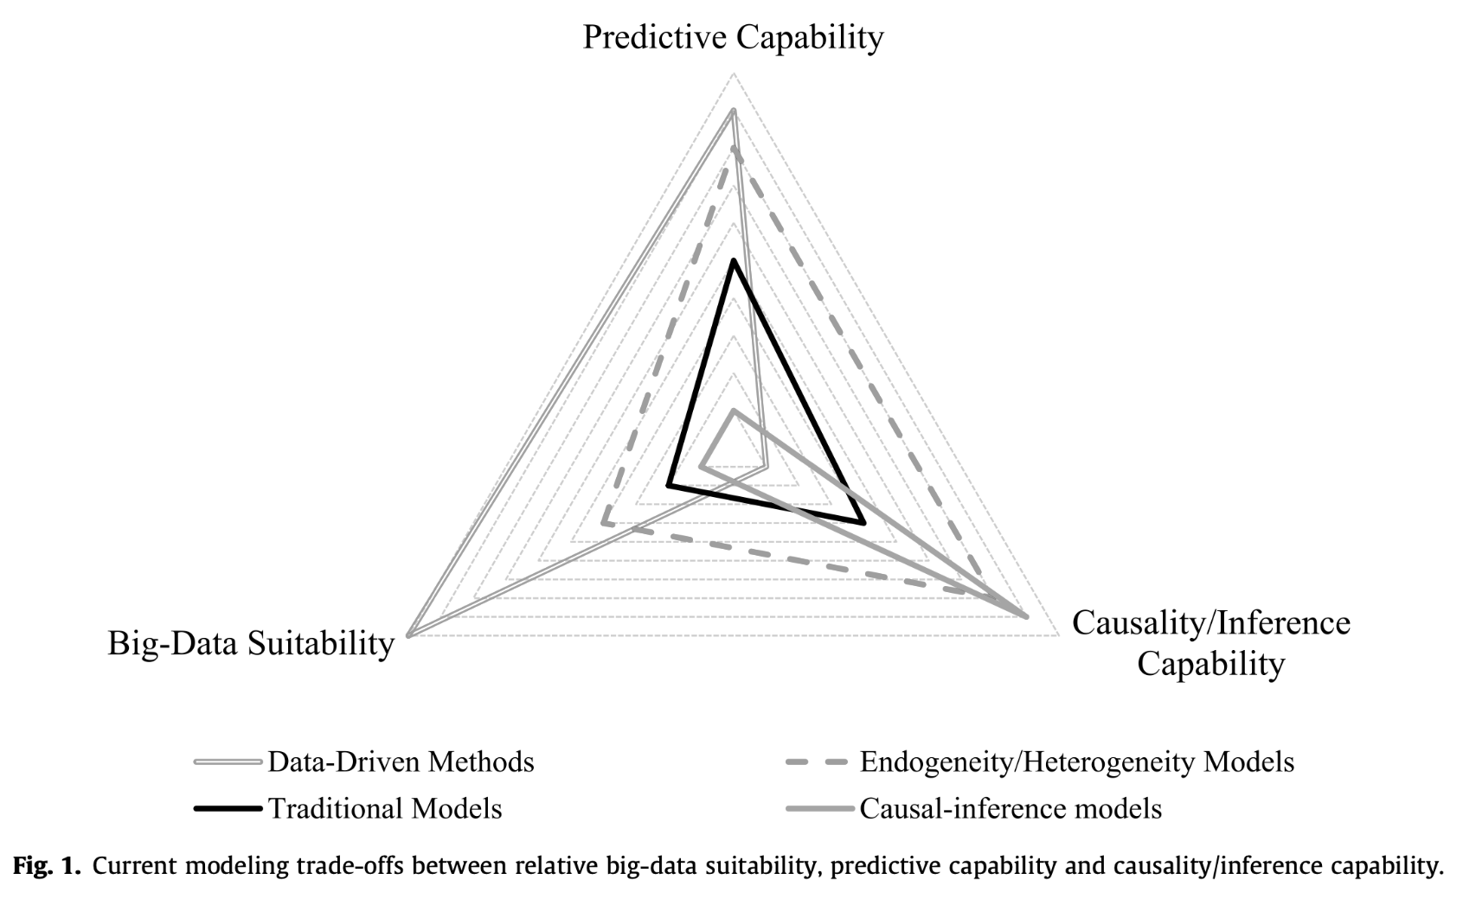
Why Discrete Choice Models
Basic DCMs (e.g., MNL, NL)
Advanced DCMs (e.g., LC, MXL, dynamic MXL)
Data-driven DCMs (e.g., IPL, AMXL,C-NN)
Source: https://www.youtube.com/watch?v=_6MnWjpd8l8
2

Slide 3
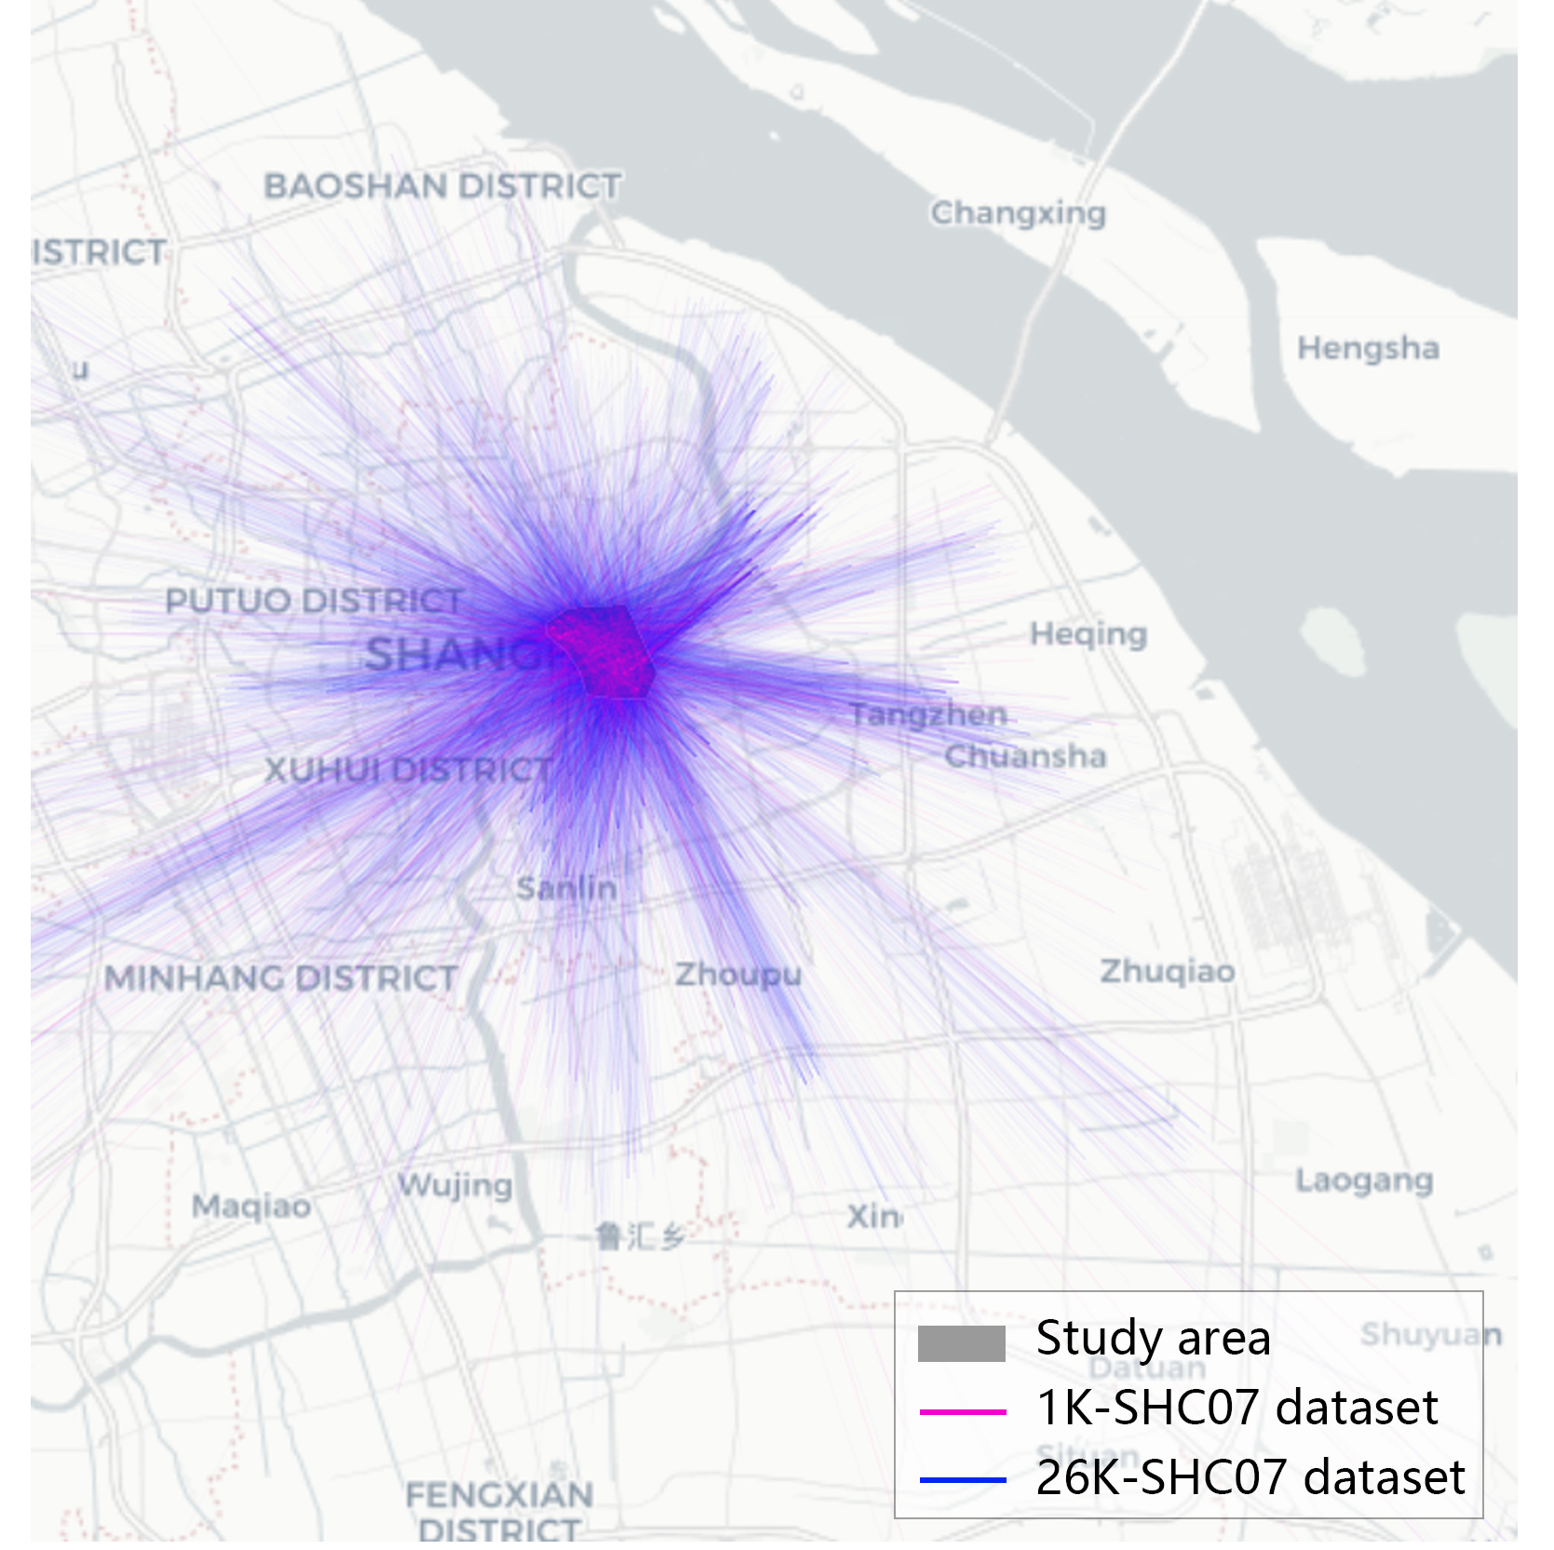
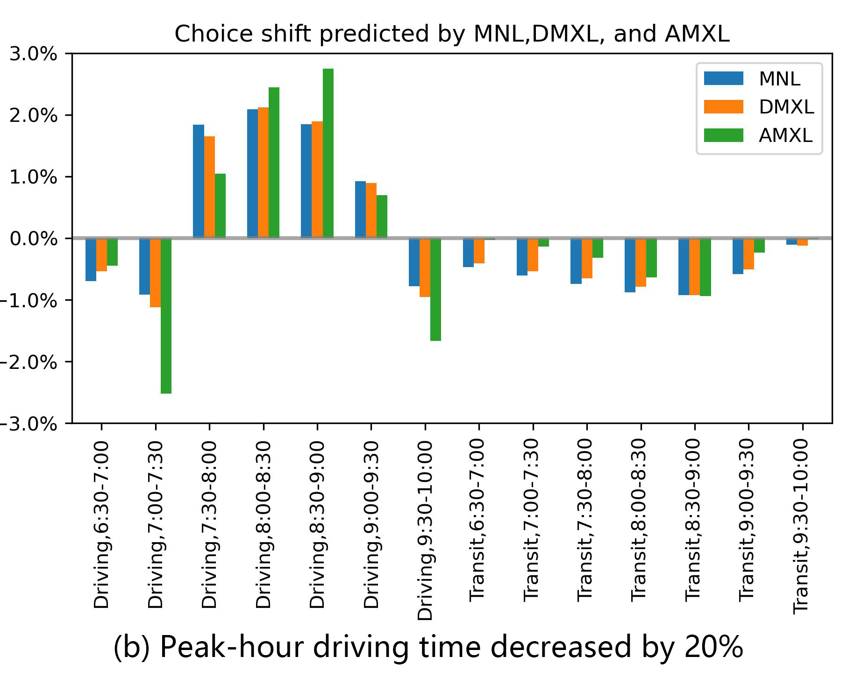
What data-driven DCMs can do
Predicting travel demand and traffic flow
Ren, X., & Chow, J. Y. (2022). A random-utility-consistent machine learning method to estimate agents’ joint activity scheduling choice from a ubiquitous data set. Transportation Research Part B: Methodological, 166, 396-418.
3

Slide 4
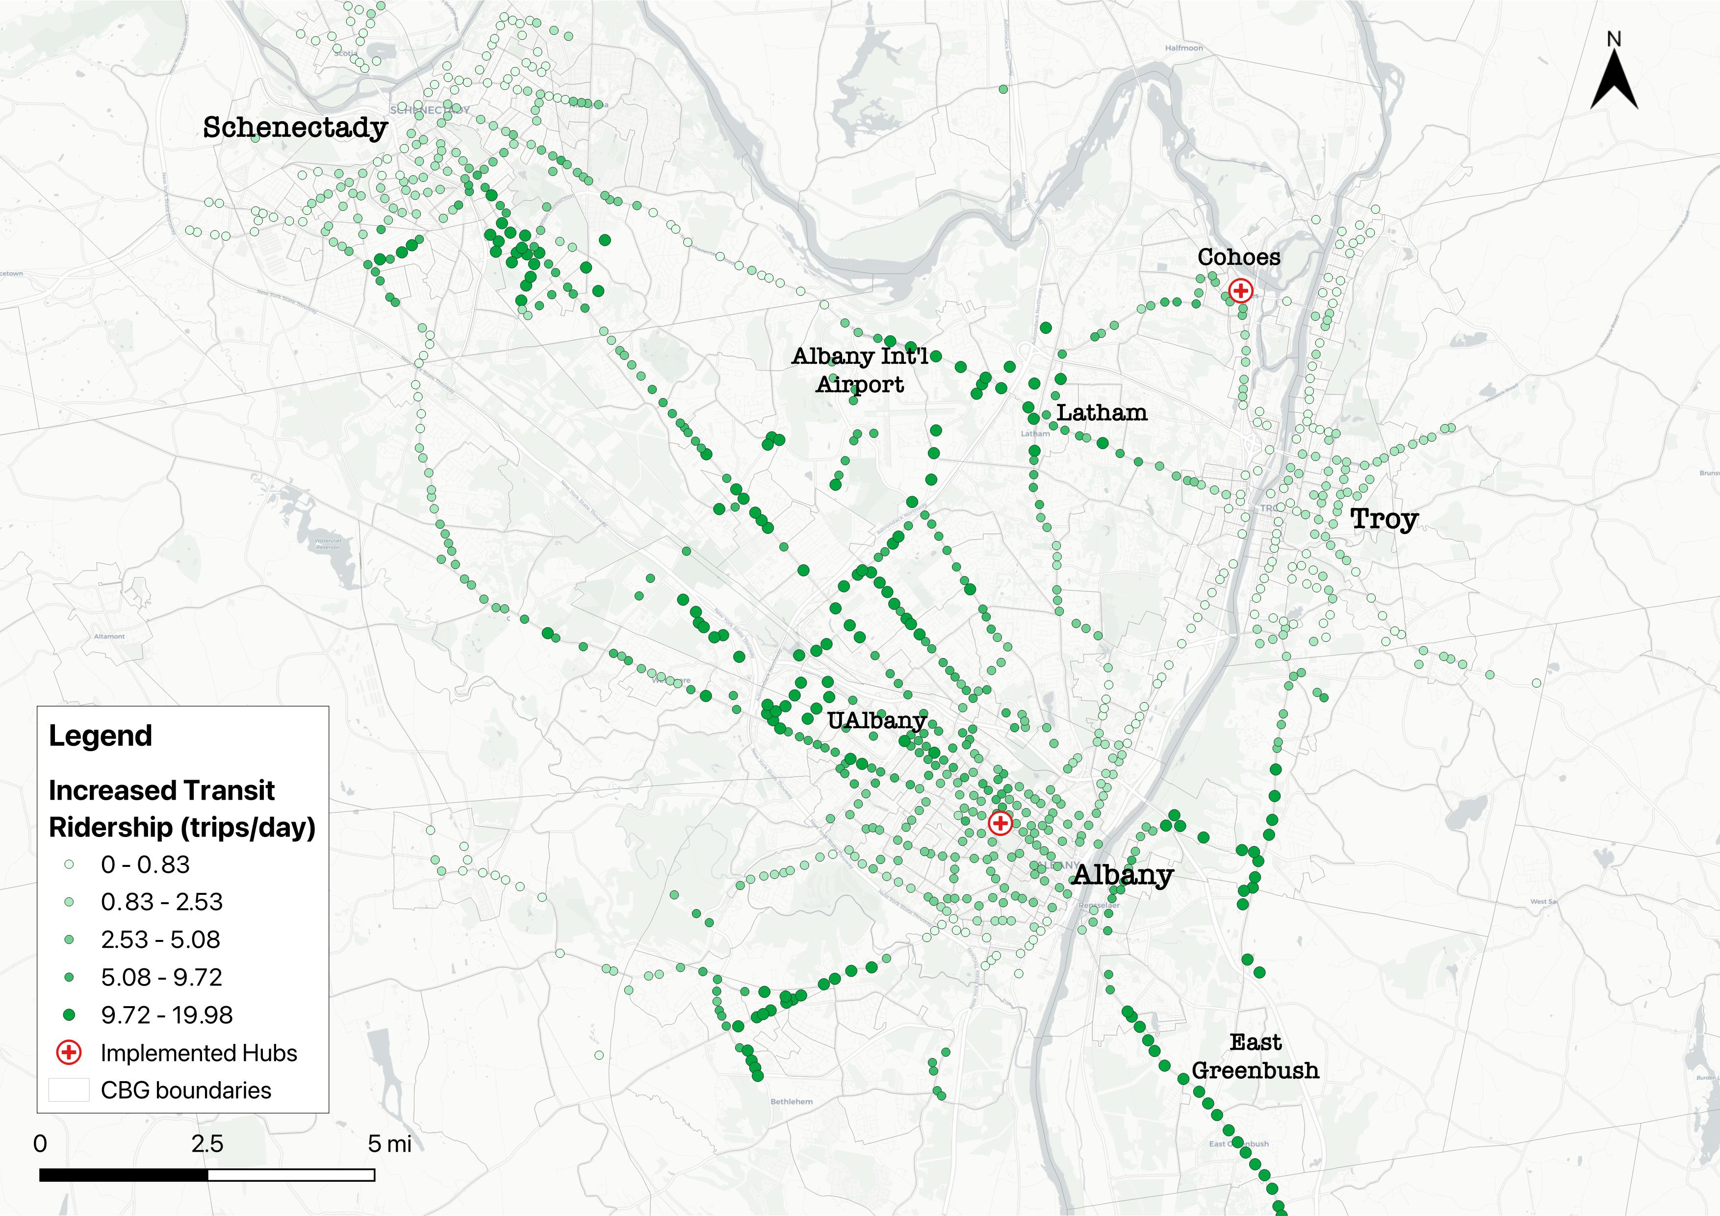
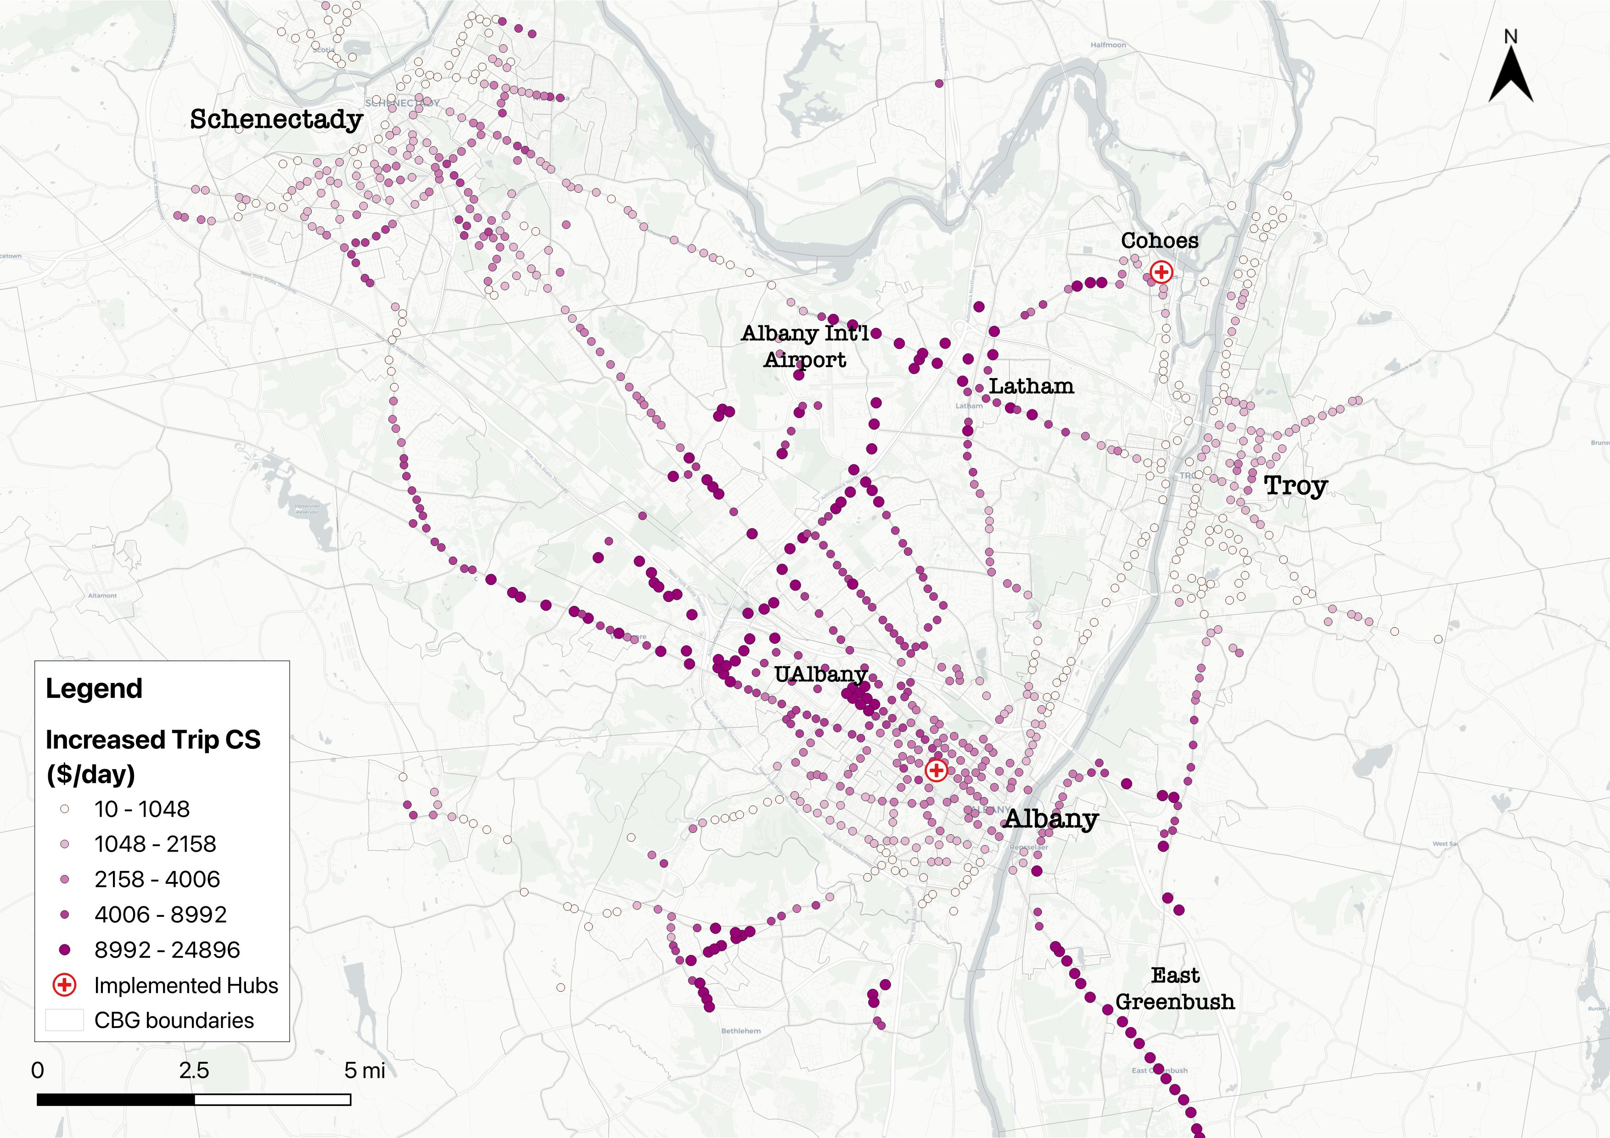
What DCMs can do
Evaluating New Infrastructure
Ren, X., Chow, J. Y., A data fusion approach for mobility hub impact assessment and location selection: integrating hub usage data into a large-scale mode choice model. Transportation Research Part A: Policy and Practice, under review. https://papers.ssrn.com/sol3/papers.cfm?abstract_id=5200375
4

Slide 5
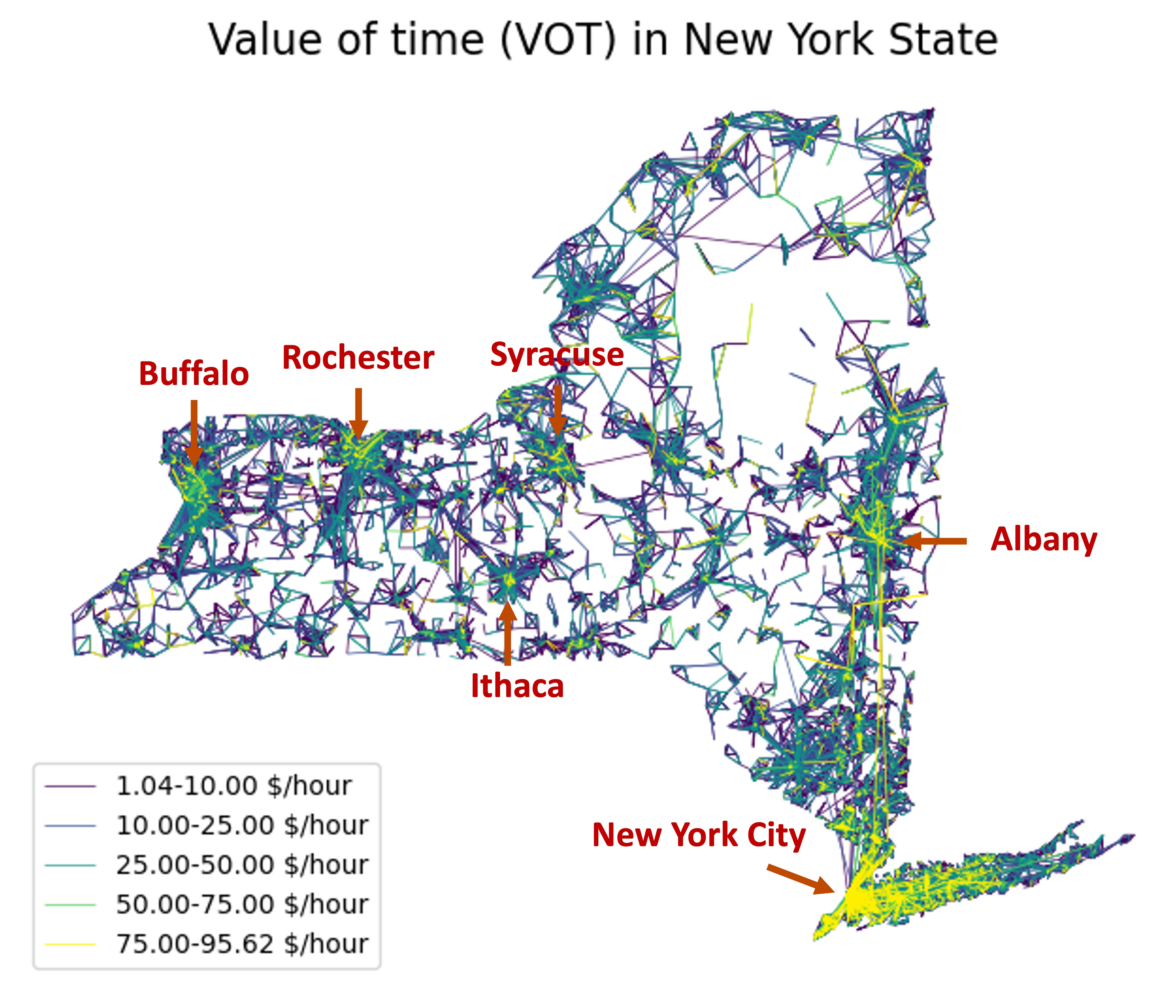
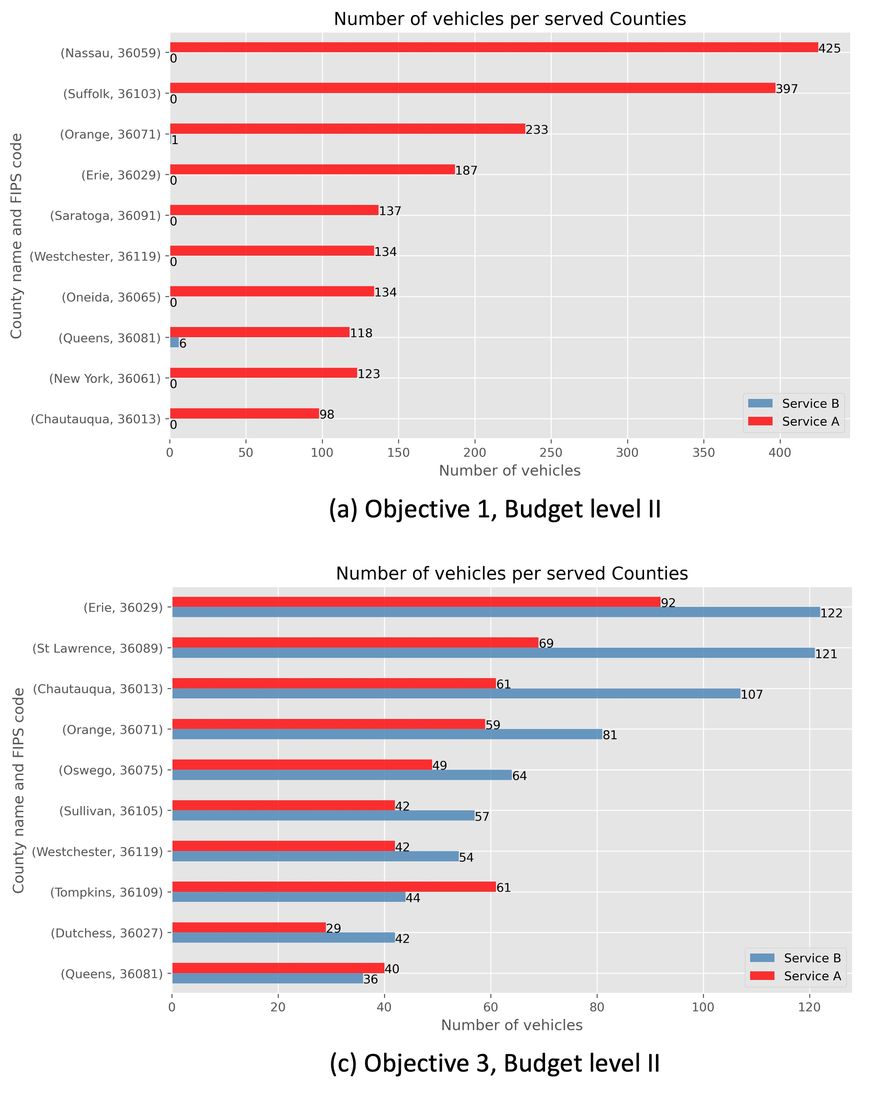
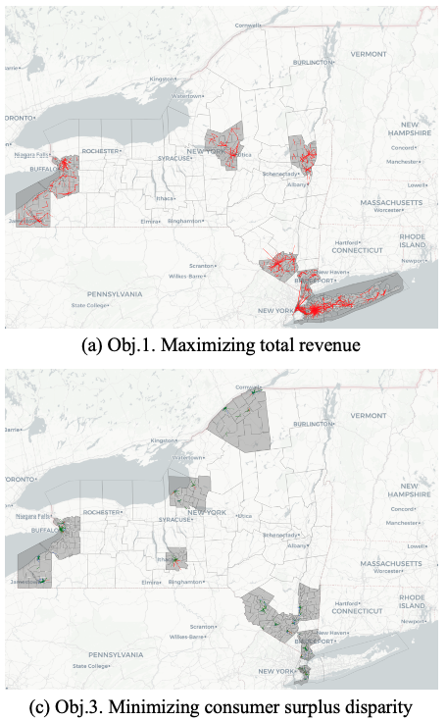
What DCMs can do
Optimizing Transportation Networks
Ren, X., Chow, J. Y., & Guan, C. (2024). Mobility service design with equity-aware choice-based decision-support tool: New York case study. Transportation Research Part D: Transport and Environment, 132, 104255.
5

Slide 6
Today you will learn
Theoretical underpinnings of DCM (5-10 min)
Decision maker, alternative, utility, choice probability
Basis of multinominal logit (MNL) and mixed logit (MXL)
Basis of agent-based mixed logit (AMXL)
How to build MNL, NL, MXL, and AMXL (25-30 min)
Data structure for choice modeling
Building MNL, MXL and interpreting the results
Building AMXL and interpreting the results
6

Slide 7
Theoretical Part

Slide 8
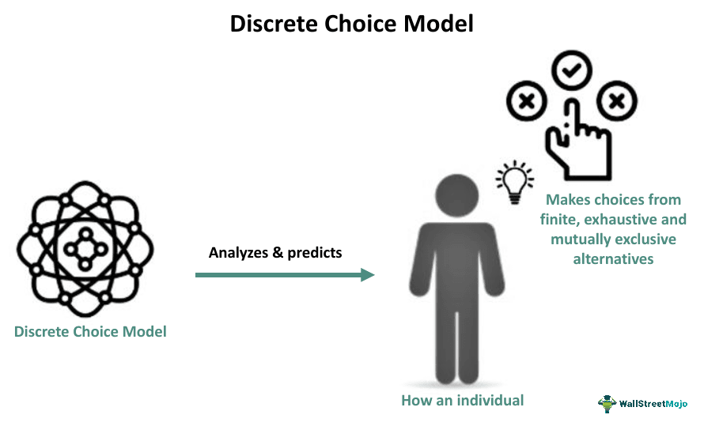
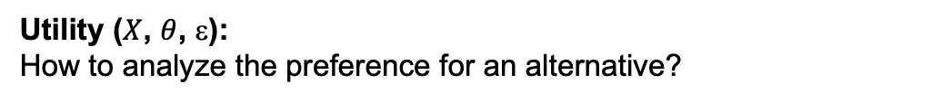

What are Discrete Choice Models
Discrete choice models are used to analyze and predict how an individual makes choices from a set of finite, exhaustive and mutually exclusive alternatives.
Decision maker:
Can be an individual or a group of individuals (e.g., travelers)
Alternative:
What options are available? (e.g., transit, taxi, biking, driving)
Utility ($X$, $θ$, $$):
How to analyze the preference for an alternative?
Choice probability (utility maximization):
How to predict the choice made by decision makers?
$$U_{nj}=V_{nj}+_{nj}={θX}_{n j}+_{nj}$$
Total utility = Systematic utility (taste parameters $θ$ * variables $X$) + Radom disturbance ($$)
$$P_{ij^{∗}}=\operatorname{Pr}\left\{U_{ij}<U_{ij^{∗}}, ∀j≠j^{∗}\right\}=Pr⁡\{ε_{ij}<ε_{ij^{∗}}+V_{ij^{∗}}−V_{ij}, ∀j≠j^{∗}\}$$
Utility maximization theory: individuals/agents make choice by maximizing the total utility they expect to gain.
8

Slide 9
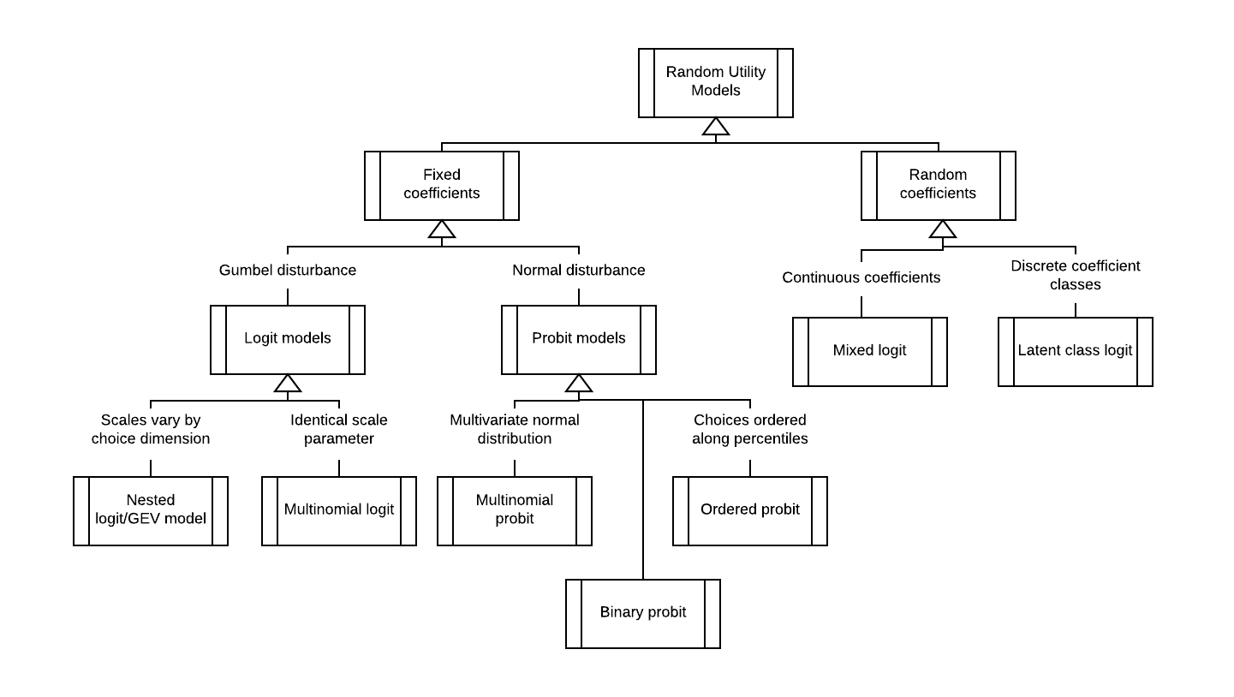

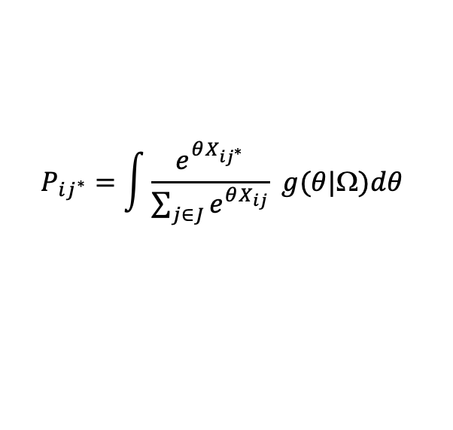

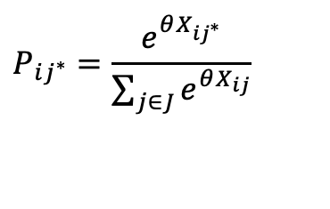

Multinomial Logit and Mixed Logit
Multinominal Logit (MNL) and Mixed Logit (MXL)
The value of $θ$ and the distribution of $_{ij}$ determine how DCMs calculate $P_{ij^{∗}}$.
Assuming $_{ij}$ to be Gumbel distributed results in logit models. Assuming $θ$ to be fixed values results in MNL model. Assuming $θ$ to be a parametric distribution (e.g., normal, uniform, triangular) results in MXL model
$$P_{ij^{∗}}=\frac{e^{θX_{ij^{∗}}}}{\sum_{j∈J}{e^{θX_{ij}}}}$$
$$P_{ij^{∗}}=\int{\frac{e^{θX_{ij^{∗}}}}{\sum_{j∈J}{e^{θX_{ij}}}} g(θ|Ω)dθ}$$
MNL form
MXL form
V_metro = -0.2*30 + -0.1*5 + 2*0 + 3*1 = -3.5
$$θ$$
$$θ$$
Variables
$$θ$$
$$θ$$
P_metro = $\frac{\text{exp}\text{(−3.5)}}{\text{exp}\text{(−4.2)}+\text{exp}\text{(−7)}+\text{exp}\text{(−3.5)}}$ = 65.65%
9

Slide 10
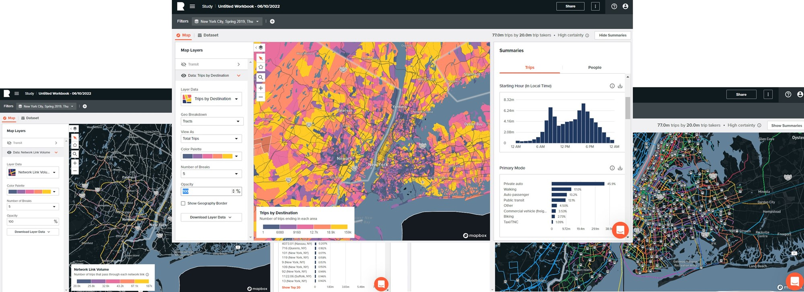

Data-driven DCMs
Multinominal Logit (MNL) and Mixed Logit (MXL)
The value of $θ$ and the distribution of $_{ij}$ determine how we calculate $P_{ij^{∗}}$.
Assuming $_{ij}$ to be Gumbel distributed results in logit models. Assuming $θ$ to be fixed values results in MNL model. Assuming $θ$ to be a parametric distribution (e.g., normal, uniform, triangular) results in MXL model
What if we have large ICT datasets for travel behavior modeling?
$$P_{ij^{∗}}=\frac{e^{θX_{ij^{∗}}}}{\sum_{j∈J}{e^{θX_{ij}}}}$$
$$P_{ij^{∗}}=\int{\frac{e^{θX_{ij^{∗}}}}{\sum_{j∈J}{e^{θX_{ij}}}} g(θ|Ω)dθ}$$
MNL form
MXL form
-0.2*30 + -0.1*5 + 2*0 + 3*1 = -3.5
$\frac{\text{exp}\text{(−3.5)}}{\text{exp}\text{(−4.2)}+\text{exp}\text{(−7)}+\text{exp}\text{(−3.5)}}$ = 0.655
10

Slide 11
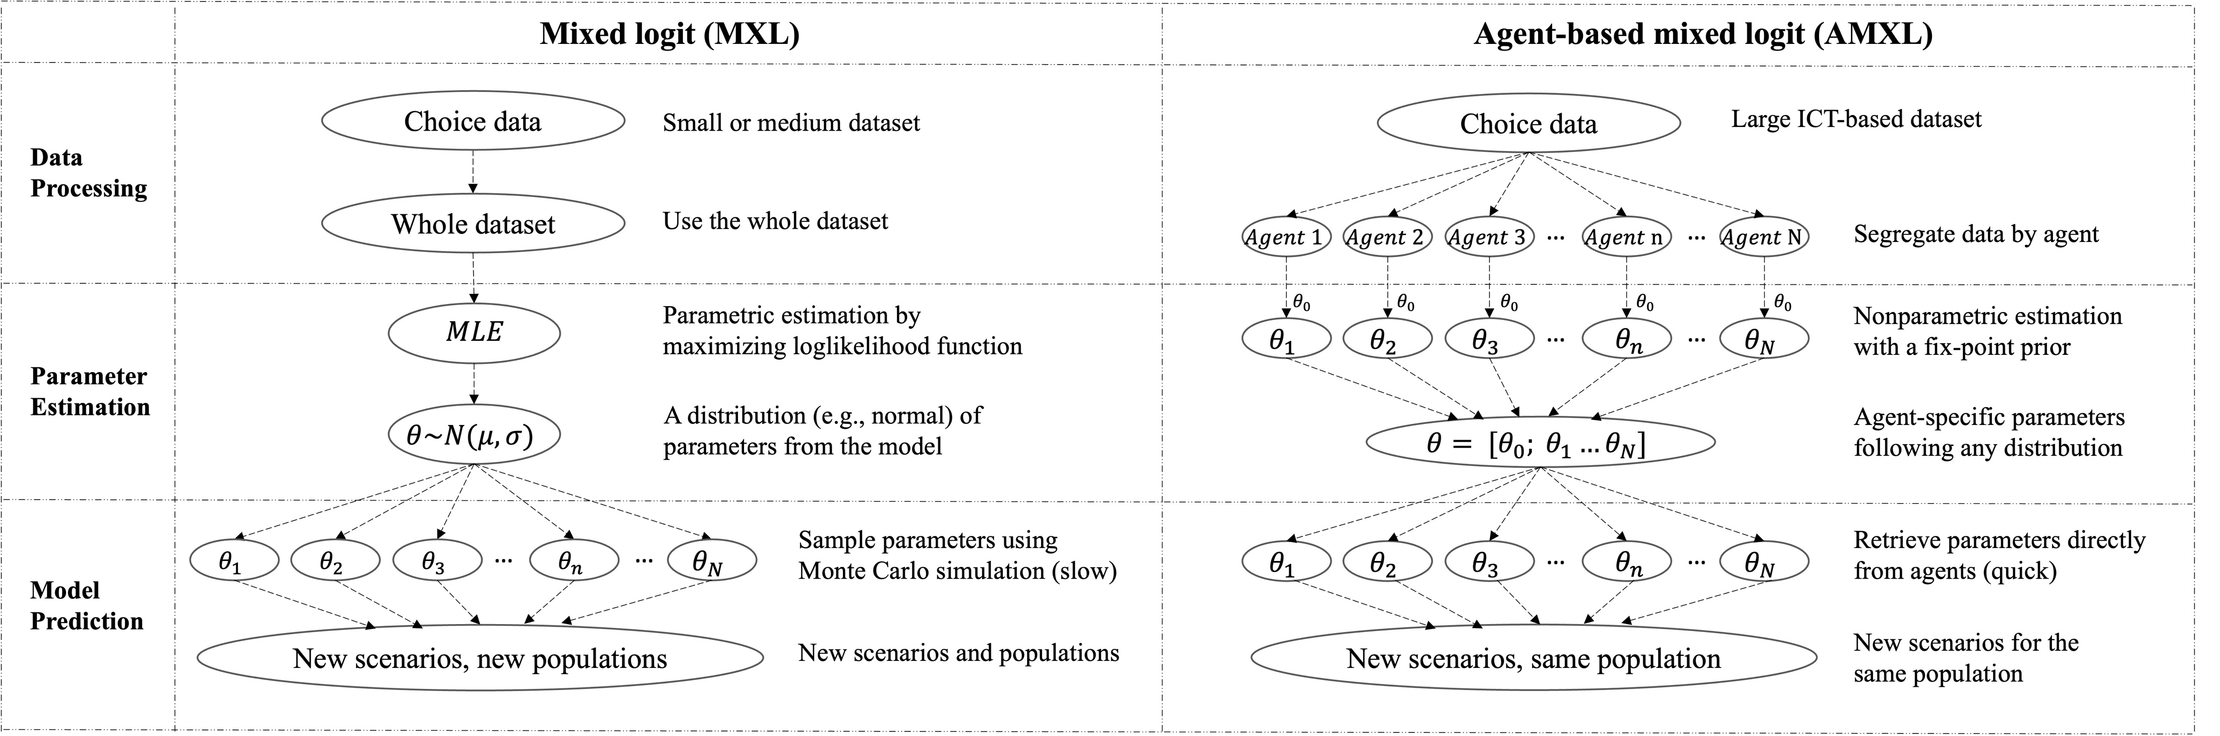
Agent-based Mixed Logit (AMXL)
AMXL is a variant of MXL, using hybrid machine learning/econometric algorithms to nonparametrically estimate taste parameters for each agent based on a large data set .
Ren, X., & Chow, J. Y. (2022). A random-utility-consistent machine learning method to estimate agents’ joint activity scheduling choice from a ubiquitous data set. Transportation Research Part B: Methodological, 166, 396-418.
11

Slide 12
Agent-based Mixed Logit (AMXL)
Traveler A
X
MNL & MXL
X
Traveler B
AMXL
12

Slide 13
Practical Part

Slide 14
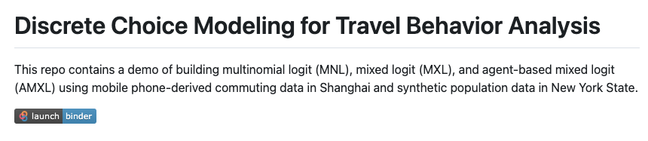
GitHub Repo
https://github.com/xr2006/C2SMART_Learning_Hub

Slide 15
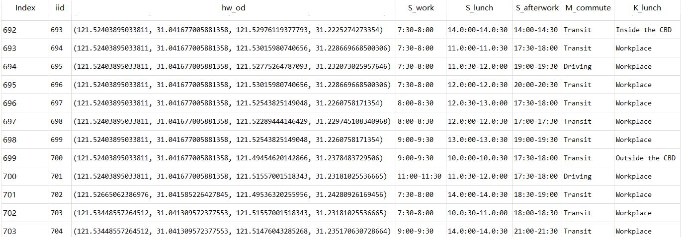
Example 1: Commute Choice Modeling
Mobile phone data for 26,149 commuters’ activity chain on two weekdays (Shanghai, 2019)
15

Slide 16
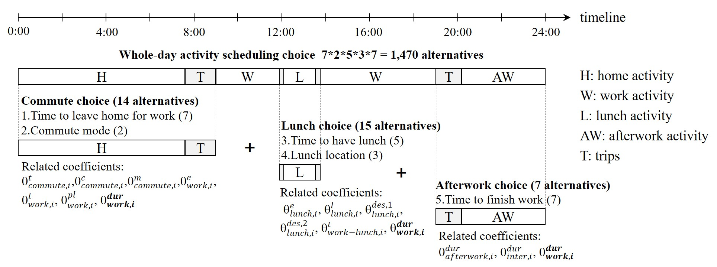
Example 1: Commute Choice Modeling
16

Slide 17
Example 1: Commute Choice Modeling
Code
17

Slide 18
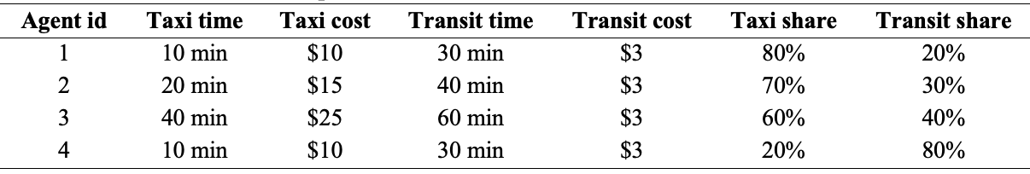
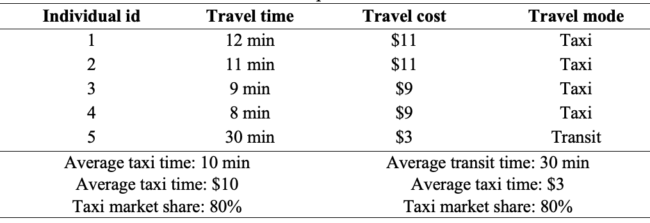
Example 2: NYS Mode Choice Modeling
Market level data
Individual level data
aggregate
If we only have observed travel time & cost for the chosen alternative (not for all alternatives), and the dataset is large enough, we can aggregate the data and build a market-level model.
18

Slide 19
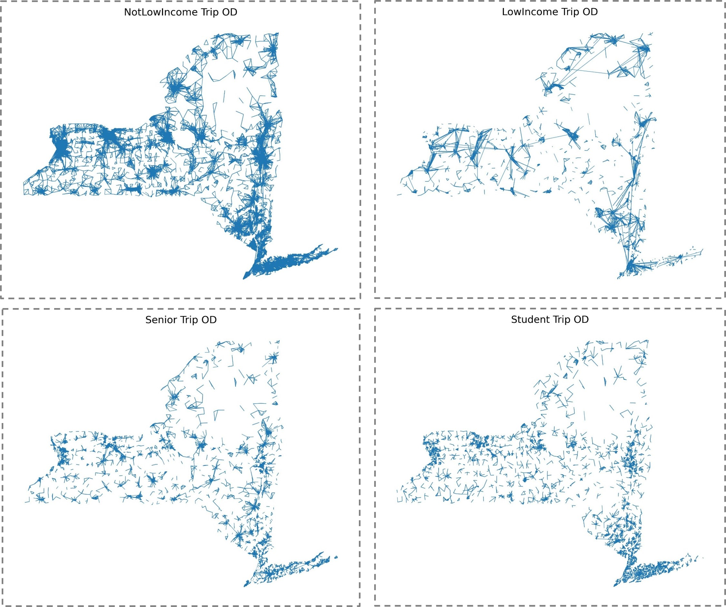
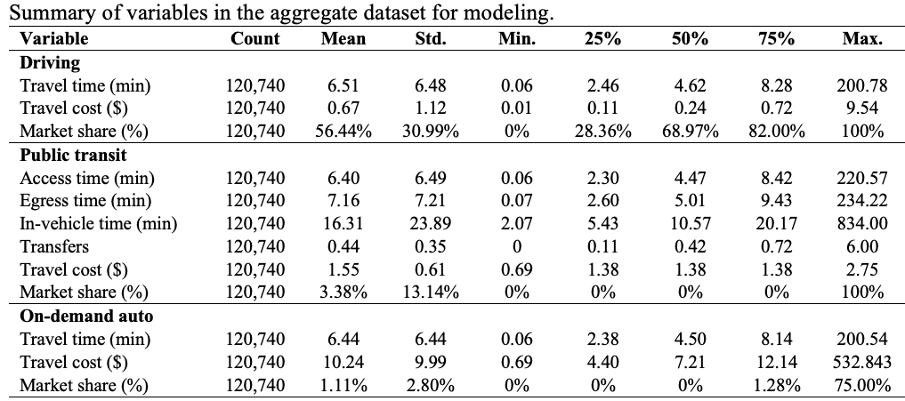
Example 2: NYS Mode Choice Modeling
Block-group OD level mode share data from Replica’s synthetic population
120,740 markets (block-group OD pair * segment)
Six modes: driving, public transit, on-demand auto, biking, walking, carpool
Twelve mode attributes: auto travel time, transit access time, transit egress time, transit in-vehicle time, number of transfer, non-vehicle travel time, cost, five mode specific constants
19

Slide 20
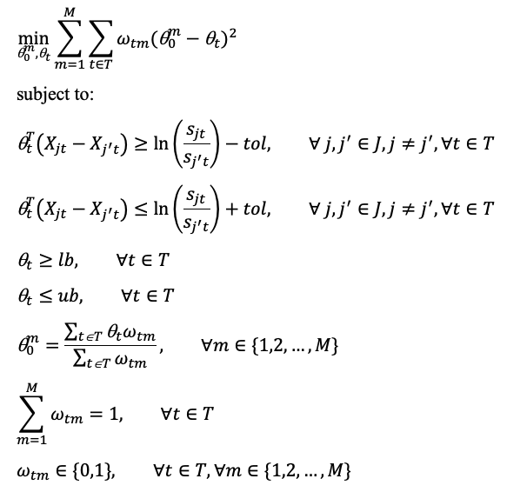
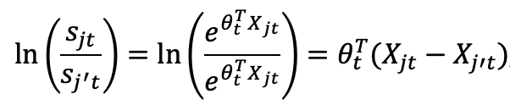
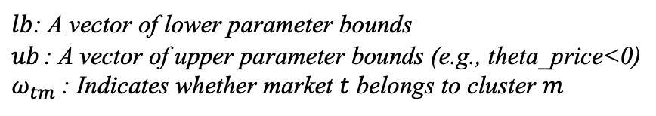
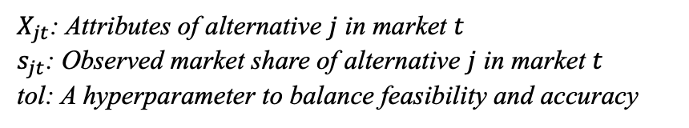
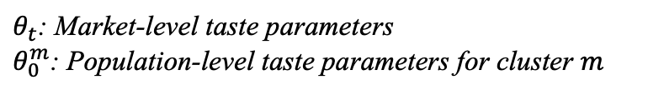
Example 2: NYS Mode Choice Modeling
1. Market-specific parameters
$θ_{t}$: Market-level taste parameters
$θ_{0}^{m}$: Population-level taste parameters for cluster $m$
2. Inverted market share constraints
$X_{jt}$: Attributes of alternative $j$ in market $t$
$s_{jt}$: Observed market share of alternative $j$ in market $t$
tol: A hyperparameter to balance feasibility and accuracy
BLP formulation
3. Parameter boundary and cluster indicator
$lb$: A vector of lower parameter bounds
$ub$: A vector of upper parameter bounds (e.g., theta_price<0)
$ω_{tm}$: Indicates whether market $t$ belongs to cluster $m$
20

Slide 21
x
Thank you for listening!
Q & A
Free free to contact me: xr2006@nyu.edu

